Slide 1

CROP RECOMMENDATION SYSTEM
Aditi Jain
Akshay Singh
Vaibhav Chauhan

Slide 2
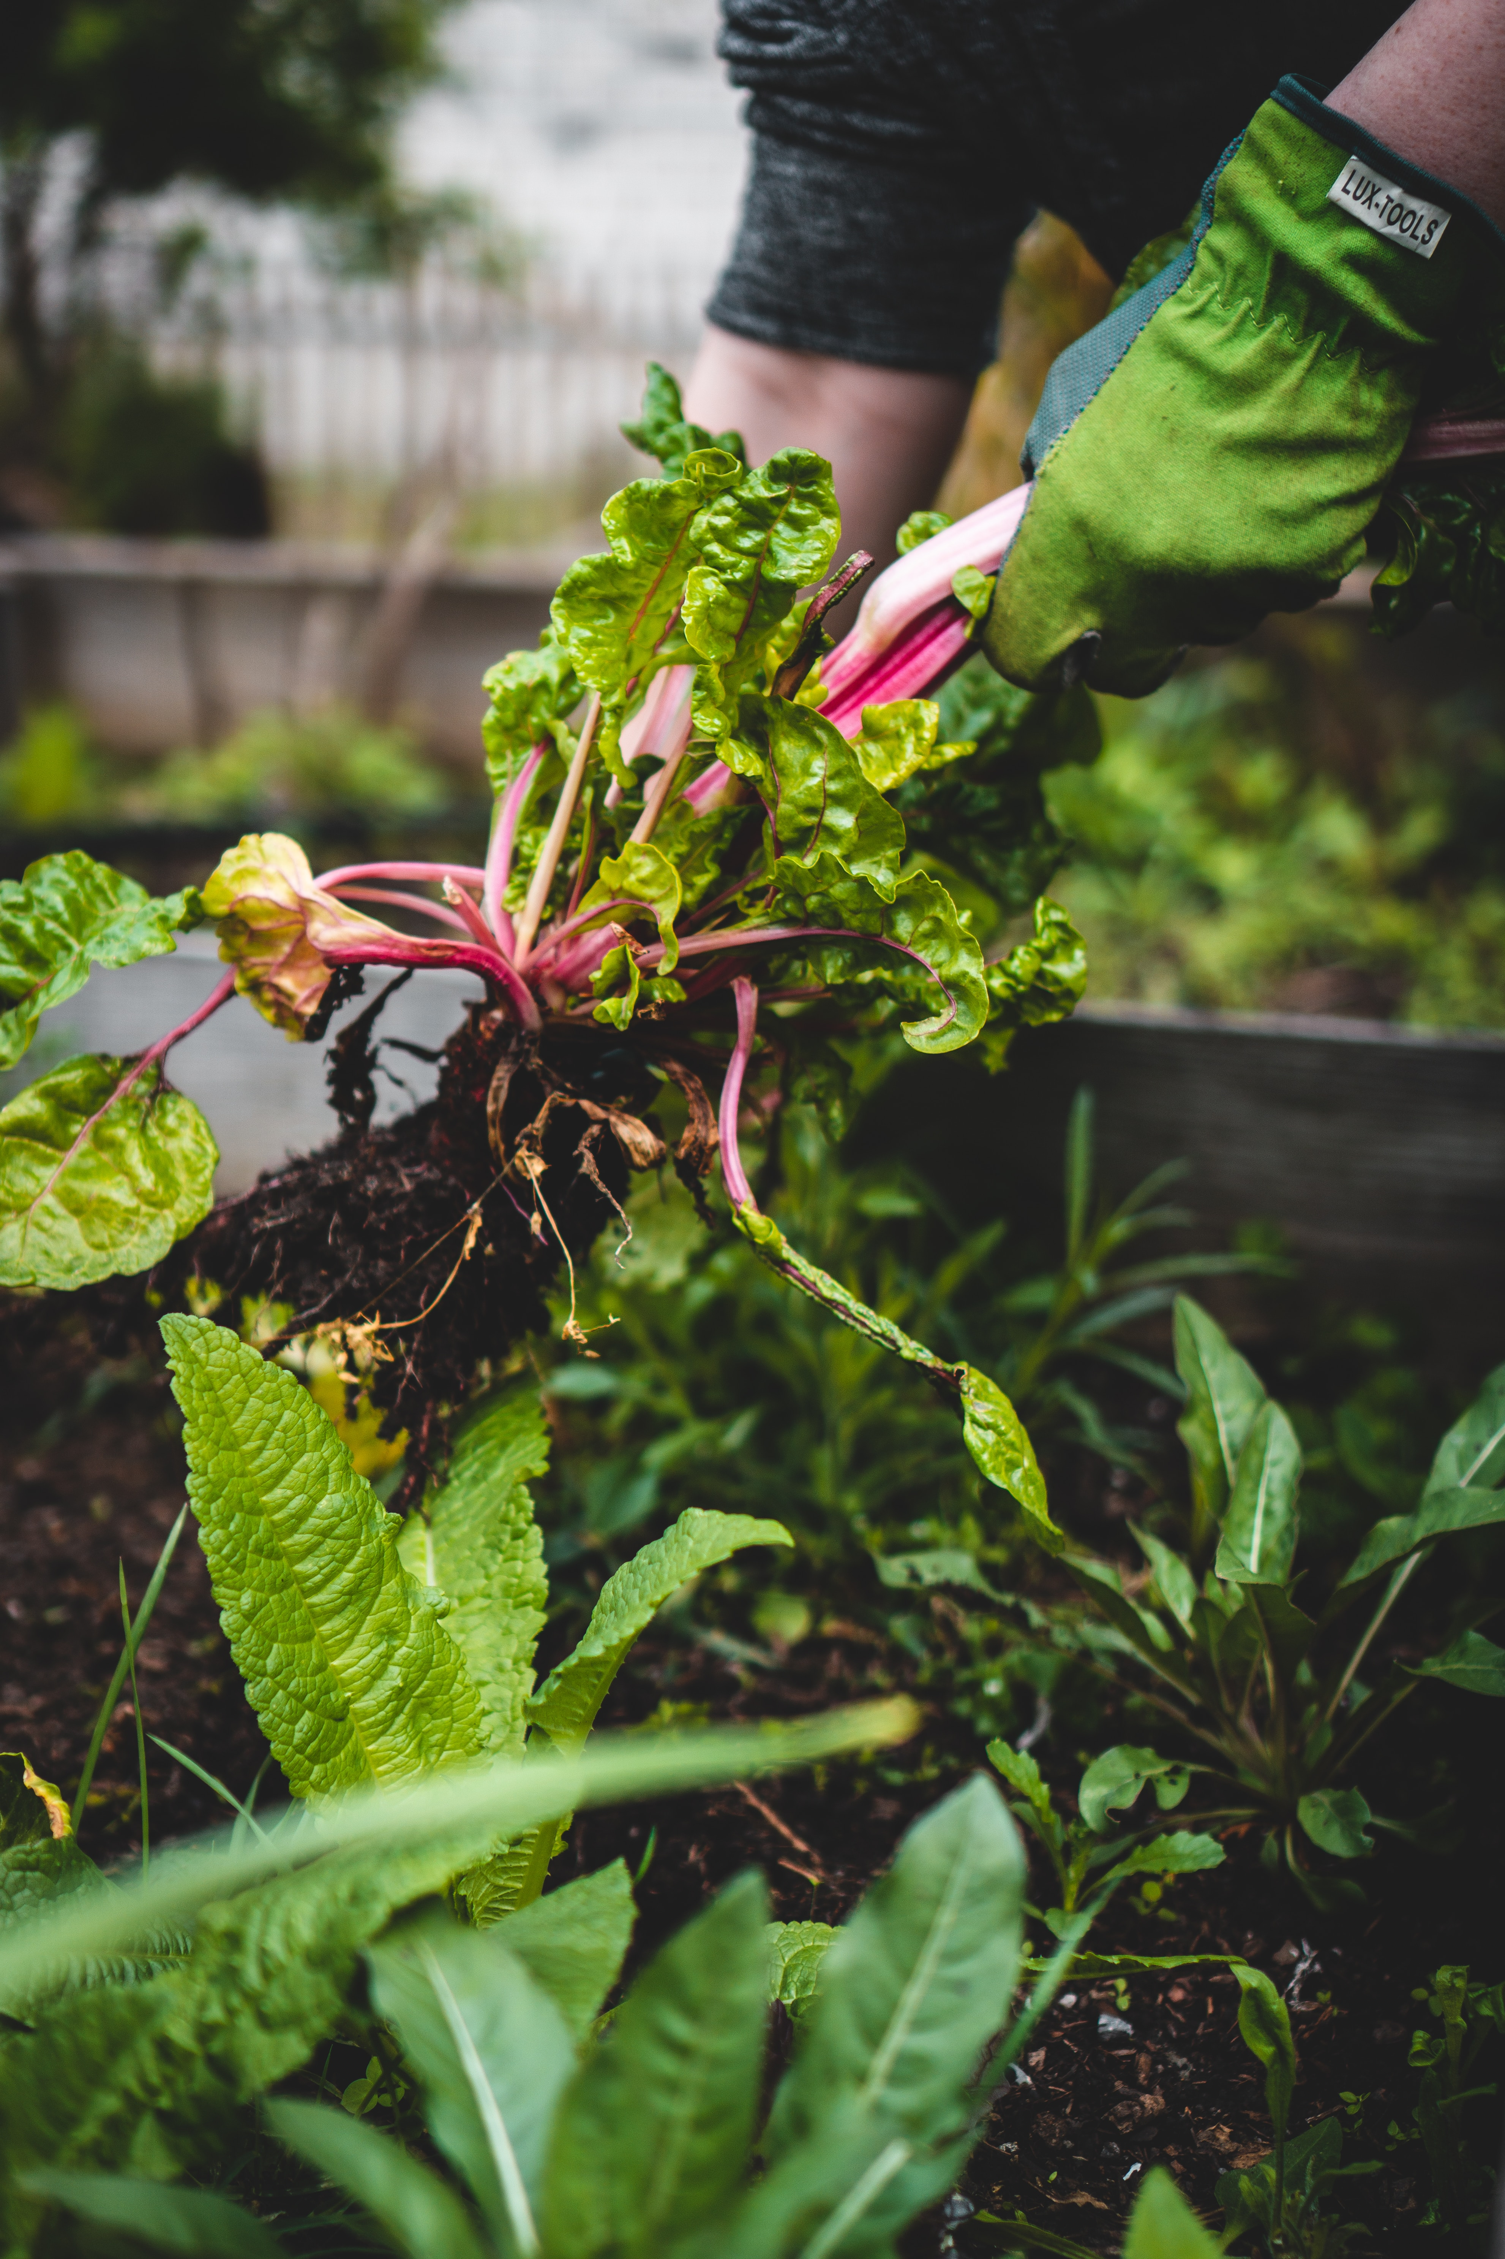
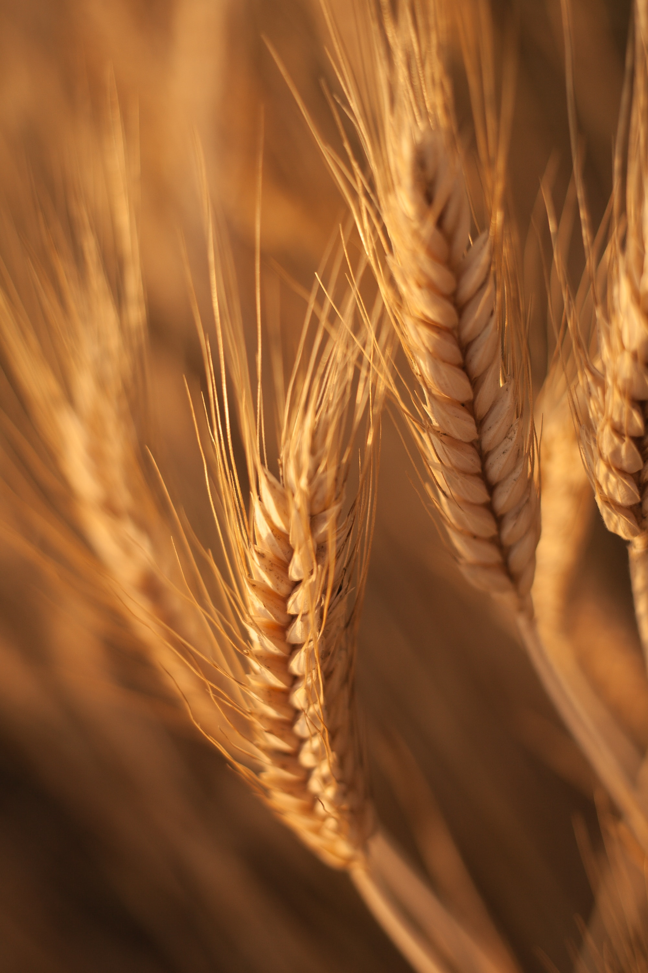
OBJECTIVE
The primary objective of this project is to develop a robust and accurate crop prediction system using machine learning techniques. The system will utilize various environmental factors such as soil pH, soil moisture, NPK (Nitrogen, Phosphorus, Potassium) content, and expected rainfall to predict the most suitable crop for a given region. This system aims to assist farmers in making informed decisions about crop selection, optimizing resource utilization, and improving agricultural yield.

Slide 3

SCOPE
Collect and integrate data on soil characteristics (pH, moisture, NPK content) from various sources.
Gather historical rainfall data for the target region.
Develop and train machine learning models to predict the best-suited crop for a given set of environmental conditions.
Implement a user-friendly interface for farmers to input their location and obtain crop recommendations.
Provide detailed information about the recommended crop, including planting guidelines.
Generate reports and insights to aid decision-making in agriculture.
The system will consider a wide range of crops suitable for the region, taking into account seasonal variations.

Slide 4

NOVELTY
The novelty of this project lies in its comprehensive approach to crop recommendation. By incorporating multiple environmental factors, historical data, and machine learning algorithms, it goes beyond simple rule-based systems and offers accurate and adaptable recommendations. Additionally, the project's user interface and reporting features make it highly accessible and practical for farmers.

Slide 5

LITERARY REVIEW
The project builds upon existing research in the field of agricultural decision support systems and crop prediction using machine learning. Relevant literature includes studies on:
Agricultural Challenges in India: The paragraph outlines the challenges faced by Indian agriculture due to repetitive cultivation practices, resulting in reduced yields, soil damage, and acidification.
Utilization of Advanced Technologies: The integration of IoT, data mining, data analytics, and machine learning in precise farming practices to reduce manual labor, increase productivity, and facilitate smart farming.
Algorithm Selection and Hyperparameter Tuning: The study employs around 10 classification algorithms, with hyperparameter tuning applied to enhance accuracy.
Addressing Farmer Welfare and Suicide Rates: The work connects farmers through a smartphone app, utilizing GPS technology and machine learning algorithms.
Addressing Farmer Welfare and Suicide Rates: The work connects farmers through a smartphone app, utilizing GPS technology and machine learning algorithms.
Precision Agriculture for Increased Productivity: India's small-scale farming landscape and heavy reliance on rain-fed agriculture are highlighted. Precision agriculture, employing ensembling techniques like Majority Voting is proposed to enhance productivity.

Slide 6
PROPOSED METHODOLOGY
Data Collection: Gather data on soil pH, soil moisture, NPK content, and historical rainfall data from various sources and regions.
Data Preprocessing: Clean and preprocess the data, handling missing values, and standardizing data formats.
Feature Engineering: Create relevant features that represent the environmental conditions accurately.
Machine Learning Model Selection: Experiment with different machine learning algorithms such as decision trees, random forests, and neural networks to determine the best model for crop prediction.
Model Training: Train the selected model using historical data.
User Interface Development: Create a user-friendly web or mobile interface where users can input their location and receive crop recommendations.
Integration: Integrate the trained model with the user interface, enabling real-time predictions.
Testing and Validation: Test the system with real-world data and validate its accuracy against known outcomes.
Deployment: Deploy the system for use by farmers in the target regions.

Slide 7
HARDWARE AND SOFTWARE REQUIREMENTS
HARDWARE
software
Entry-level multi-core processor (e.g., Intel Core i3 or AMD Ryzen 3) with a minimum of 4 cores.
8 GB of RAM or above.
2 GB HDD or SSD storage
Standard monitor (e.g., 21-inch 1080p display) for basic data visualization and code editing.
Server or cloud-based infrastructure for hosting the system.
Programming languages (Python, JavaScript).
Integrated Development Environment (Visual Studio Code, Jupyter Notebook)
Machine learning libraries (scikit-learn, TensorFlow, or PyTorch).
Web development frameworks (Django, Flask, React, or Angular).
Data visualization tools (Matplotlib, D3.js).
Web hosting and domain for deployment.

Slide 8
MODULE DESCRIPTION
Data Collection Module: This module collects data from various sources, including soil sensors, weather stations, and historical databases.
Data Preprocessing Module: It handles data cleaning, transformation, and integration to prepare the data for analysis.
Machine Learning Module: This module includes model training, validation, and testing using environmental data and crop yield information.
User Interface Module: A user-friendly interface where farmers can input their data and receive crop recommendations.

Slide 9
FUNCTIONALITIES
Input Data: Users can input Nitrogen - Potassium - Phosphorus values, temperature, humidity and average rainfall etc.
Auto- Fill Data: Users will be prompted to allow access to their location and if they allow then the temperature and humidity values will be fetched automatically by using the user’s longitude and latitude.
Processing: Using the input data, the system finds out the most suitable crop based on environmental factors.
Crop Recommendation: After getting the recommendations, the most suitable crop is shown to the user on the user interface.

Slide 10
TIMELINE
Project Planning and Research
(Aug 23 – Sep 23)
Data Collection and Pre-processing
(Sept 23 - Oct 23)
Machine Learning Model Development
(Nov 23 – Dec 23)
User Interface Design and Development
(Jan 24 – Feb 24)
Deployment and Testing
(Feb 24 – March 24)

Slide 11
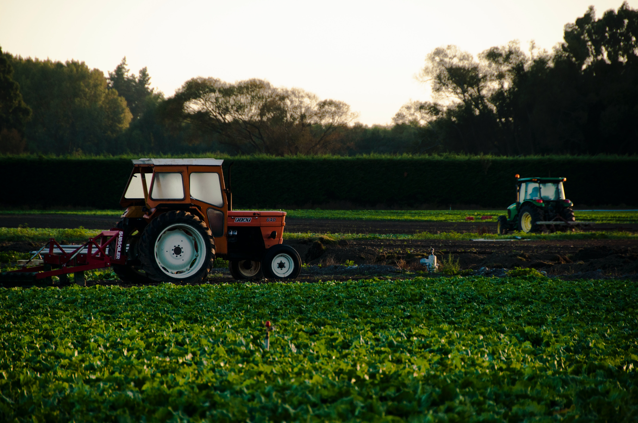
RESULTS
The proposed work presents a web application that requires least technical knowledge to operate so that farmers can easily use it to get the best suitable crop by entering values of NPK and rainfall.
The proposed work uses an ensemble of Naïve Bayes and Random Forest by employing the voting classifier strategy. The proposed work achieved an accuracy of 99.54%.

Slide 12
CONCLUSION
The Crop Recommendation System (CRS) presented in this research offers a comprehensive solution to the challenges faced by farmers in crop selection. By leveraging an ensemble of classifiers such as Naive Bayes and Random Forest, the CRS provides personalized recommendations based on farm-specific conditions. The integration of machine learning algorithms ensures accurate predictions, enabling farmers to make informed decisions that maximize productivity and profitability. Additionally, the web application interface enhances accessibility, allowing farmers to easily input their environmental conditions and receive timely recommendations.

Slide 13
FUTURE SCOPE
Future enhancements may include refining the prediction models by incorporating additional data sources such as satellite imagery and drone technology to provide more accurate and real-time insights. Moreover, expanding the web application's features to include educational resources, market analysis, and weather forecasts can empower farmers with a comprehensive toolkit for decision-making. Collaborations with agricultural extension services and government agencies can facilitate widespread adoption of the CRS, fostering a culture of data-driven farming practices and contributing to the advancement of agricultural sustainability on a broader scale.

Slide 14


References (IEEE Format)
Mahendra N, Dhanush Vishwakarma, Nischitha K, Ashwini, Manjuraju M. R, 2020, Crop Prediction using Machine Learning Approaches, INTERNATIONAL JOURNAL OF ENGINEERING RESEARCH & TECHNOLOGY (IJERT) Volume 09, Issue 08 (August 2020)
Senthil Kumar Swami Durai, Mary Divya Shamili, Smart farming using Machine Learning and Deep Learning techniques, Decision Analytics Journal, Volume 3, 2022, 100041, ISSN 2772-6622, https://doi.org/10.1016/j.dajour.2022.100041
Madhuri Shripathi Rao et al 2022 J. Phys.: Conf. Ser. 2161 012033 “Crop Prediction using Machine Learning”
Bandara, P.; Weerasooriya, T.; T.H., R.; Nanayakkara, W.; M.A.C, D.; M.G.P, P. Crop Recommendation System. Int. J. Comput. Appl. 2020, 175, 22–25, https://doi.org/10.5120/ijca2020920723.
R. Jadhav and D. P. Bhaladhare, "A Machine Learning Based Crop Recommendation System: A Survey," Journal of Algebraic Statistics, vol. 13, no. 1, pp. 426–430, May 2022.
Rajak, Rohit Kumar, Ankit Pawar, Mitalee Pendke, Pooja Shinde, Suresh Rathod, and Avinash Devare. "Crop recommendation system to maximize crop yield using machine learning technique." International Research Journal of Engineering and Technology 4, no. 12 (2017): 950-953.

Slide 15
Thank you

